Slide 1

Final Year Project
Harcourt Butler Technical University, Kanpur
Bachelor of Technology (2019-2023)
Computer Science and Engineering
Blockchain Based Property Registration

Slide 2
Team Members
Mentor
Dr. Vivek Singh Verma
Ekansh Verma
190104026
Leader
Ayush Gaur
190104019
Neeraj Kumar Singh
190104044
Mansi Prajapati
190104038

Slide 3
Problem Statement
People seeking to buy land often have to go through rigorous surveying and researching to find a plot that suits their needs and matches their budget. Even after a person finds the ideal land, they might find themselves swamped with paperwork and documentation to get the land transferred and registered under their name.
Personal data required to successfully execute the paperwork of a land deal is often very sensitive and it is highly crucial that the data be properly safeguarded to prevent it from falling into the wrong hands.

Slide 4
Objective
The elimination of middlemen: The elimination of middlemen or brokers makes the process of land registration less expensive. Brokers who try to defraud uninformed people will be unable to do so any longer. Brokers frequently take a long time to finish procedures, thus our project will help people save time.
A distributed tamper-proof ledger that prohibits ownership fraud.
IPFS(Inter-Planetary File System) is used to store important property registration papers in a secure manner.

Slide 5
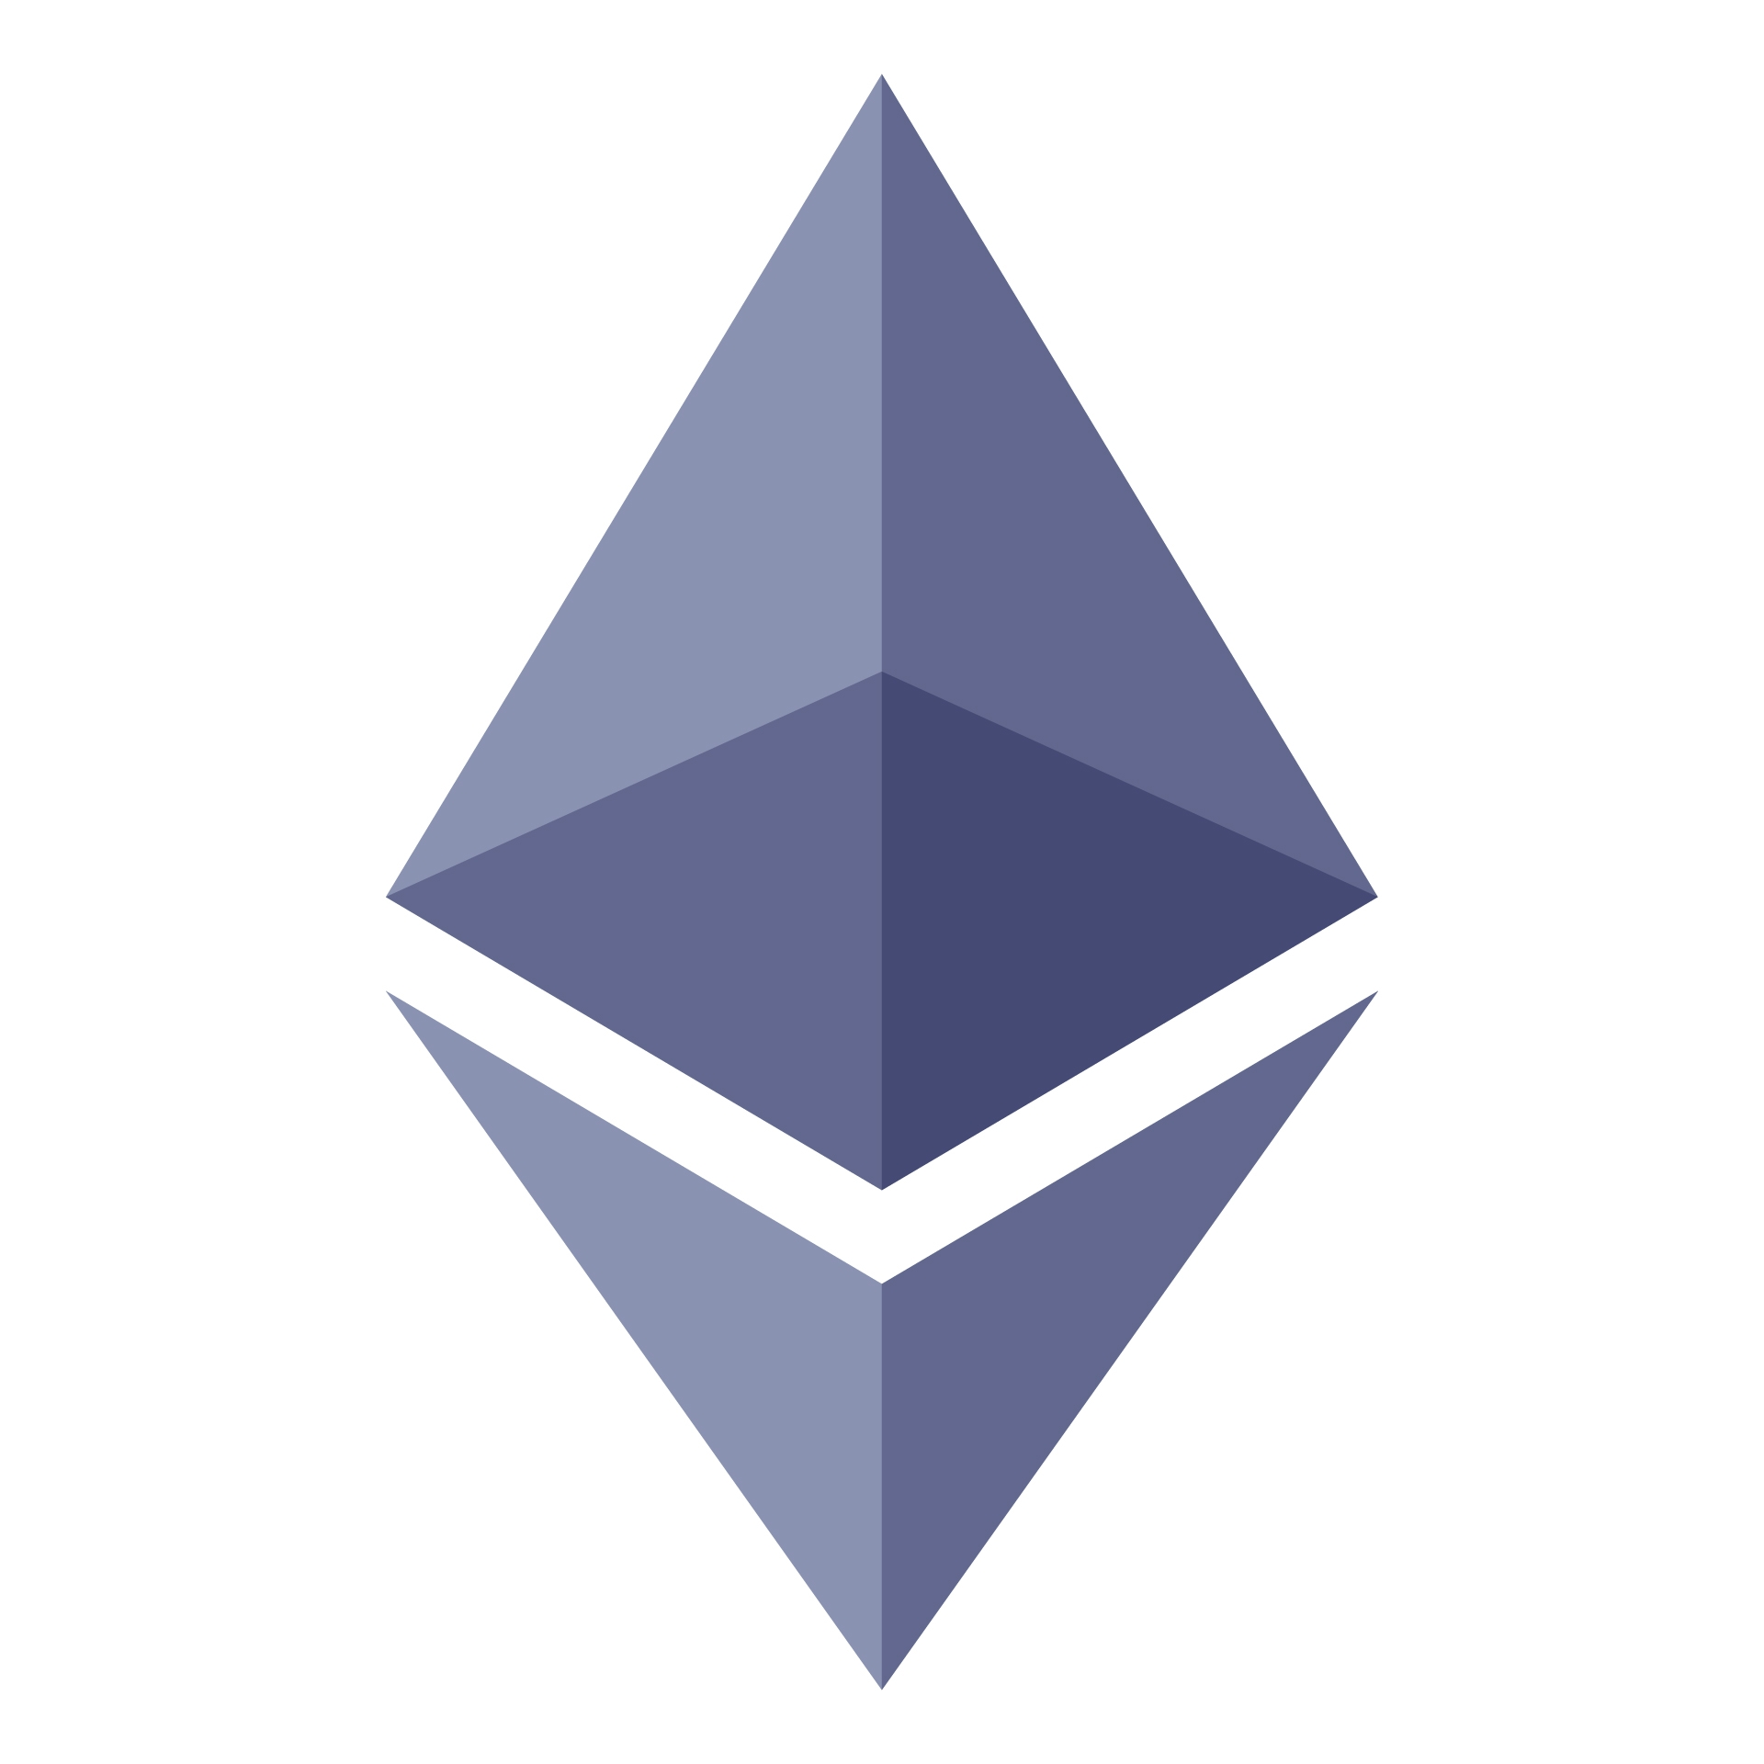
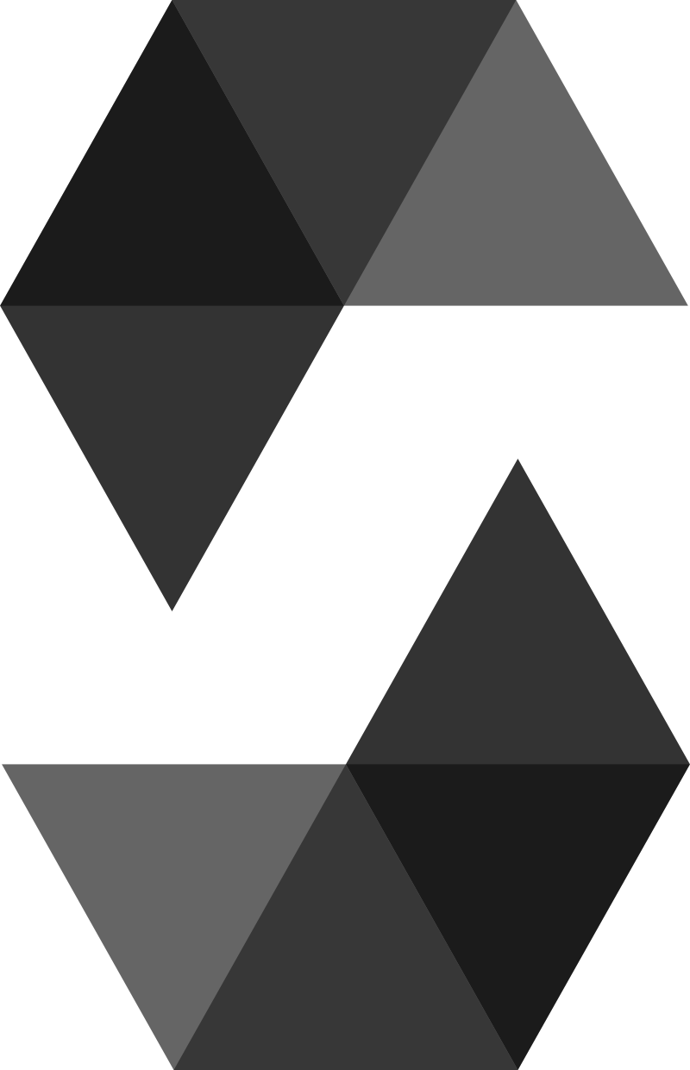
Tech Stack
Ethereum Blockchain
Ethereum is a decentralized blockchain platform that establishes a peer-to-peer network that securely executes and verifies application code, called smart contracts. Smart contracts allow participants to transact with each other without a trusted central authority. Transaction records are immutable, verifiable, and securely distributed across the network, giving participants full ownership and visibility into transaction data.
Solidity
Solidity is an object-oriented programming language created specifically by the Ethereum Network team for constructing and designing smart contracts on Blockchain platforms. It acts as a tool for creating machine-level code and compiling it on the Ethereum Virtual Machine (EVM). It's used to create smart contracts that implement business logic and generate a chain of transaction records in the blockchain system.

Slide 6
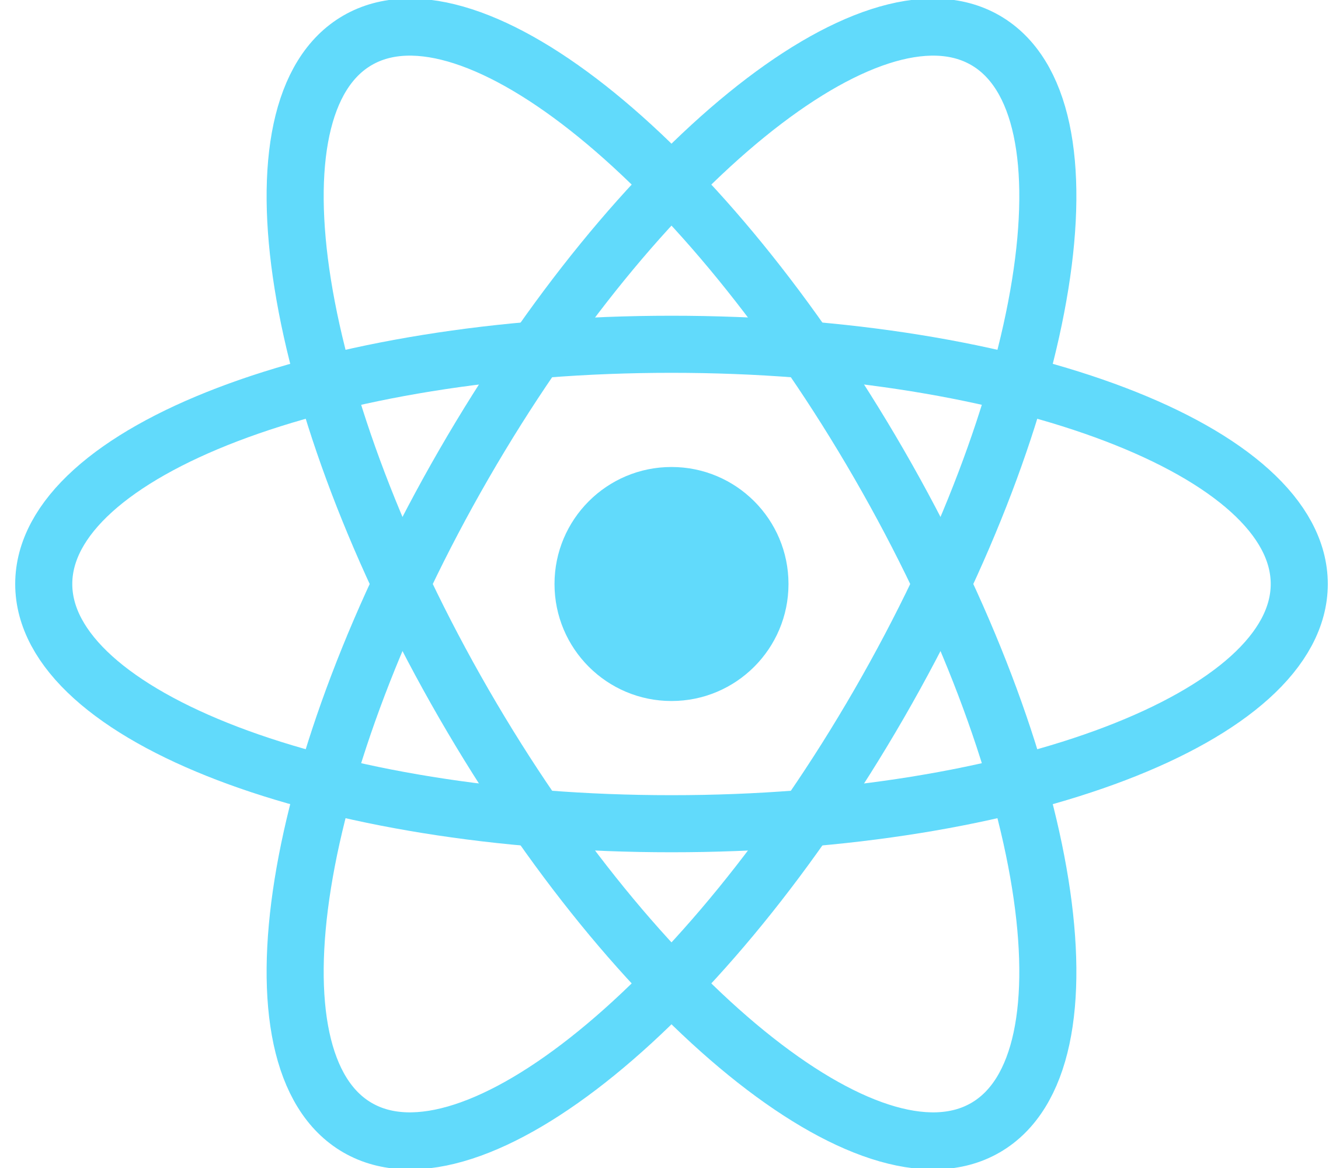

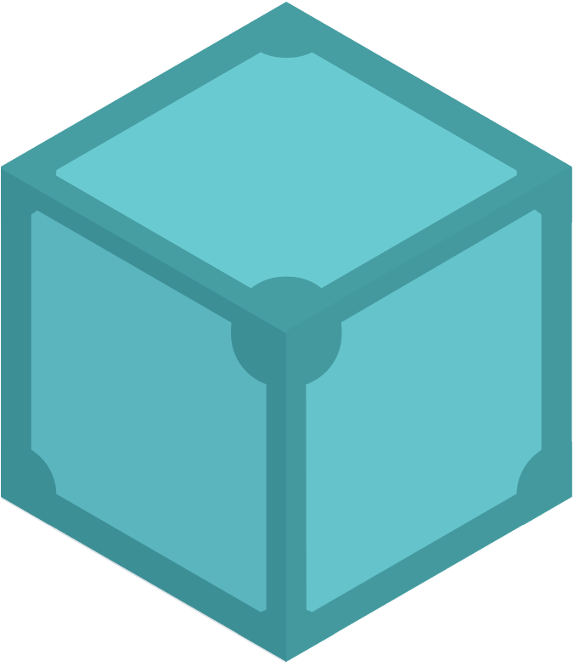
ReactJS
React is a free and open-source component-based front-end JavaScript library for building user interfaces based on UI components. React can be used as a base in the development of single-page, mobile, or server-rendered applications with framework.
NodeJS
Node.js is a free, open-sourced, cross-platform JavaScript run-time environment that lets developers write command line tools and server-side scripts outside of a browser.
IPFS
IPFS(InterPlanetary File System) is a versioned file system for storing and accessing files, websites, applications, and data. It also defines how files move across a network, making it a distributed file system.

Slide 7
Flow of Project
UI/UX Design
Database Schema Creation
Phase-Wise
Implementation
UI Development
Creating Web Services
Integration of Solidity (for contract creation)
Web Hosting

Slide 8
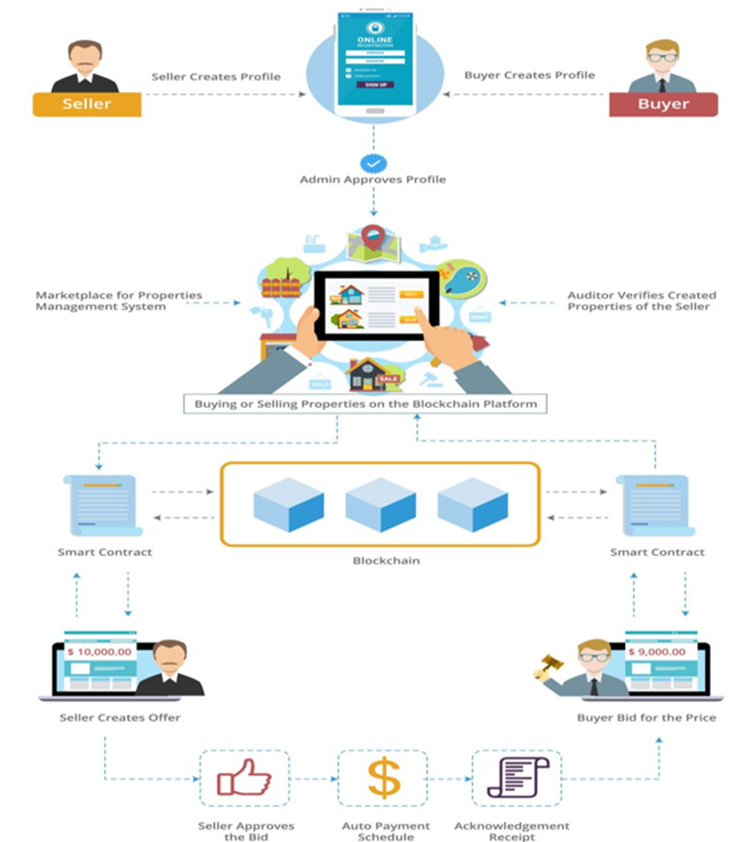
Abstract View

Slide 9
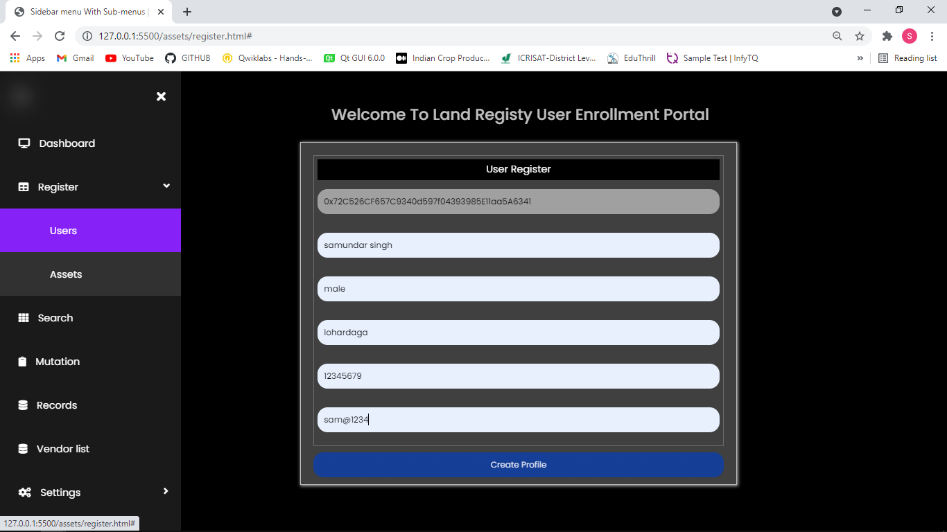
Work Completed

Slide 10
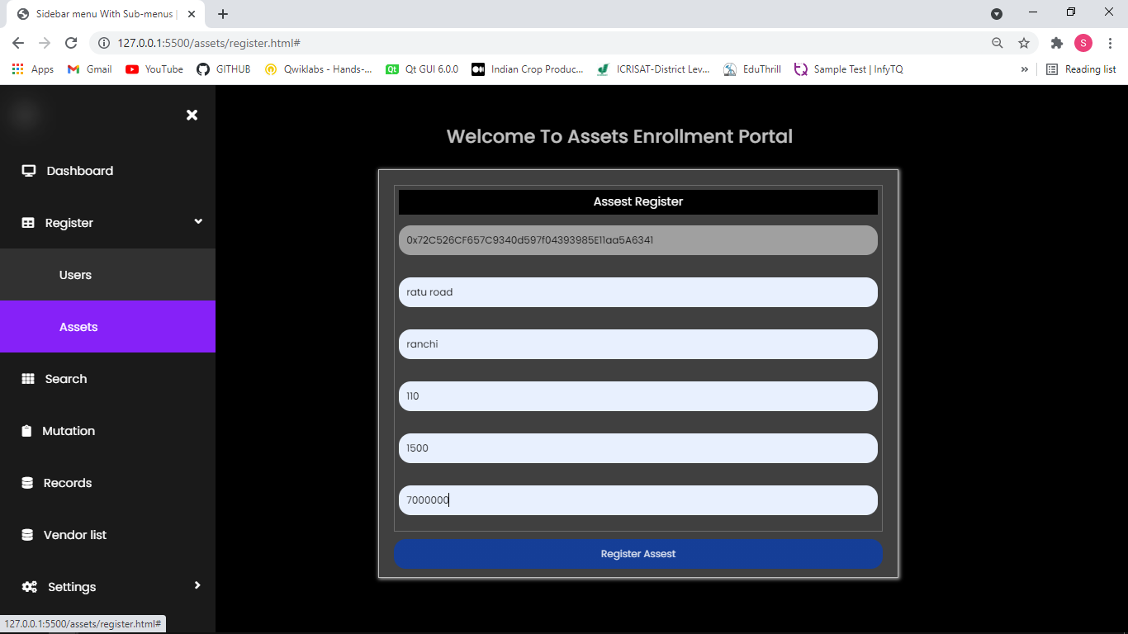
Work Completed

Slide 11
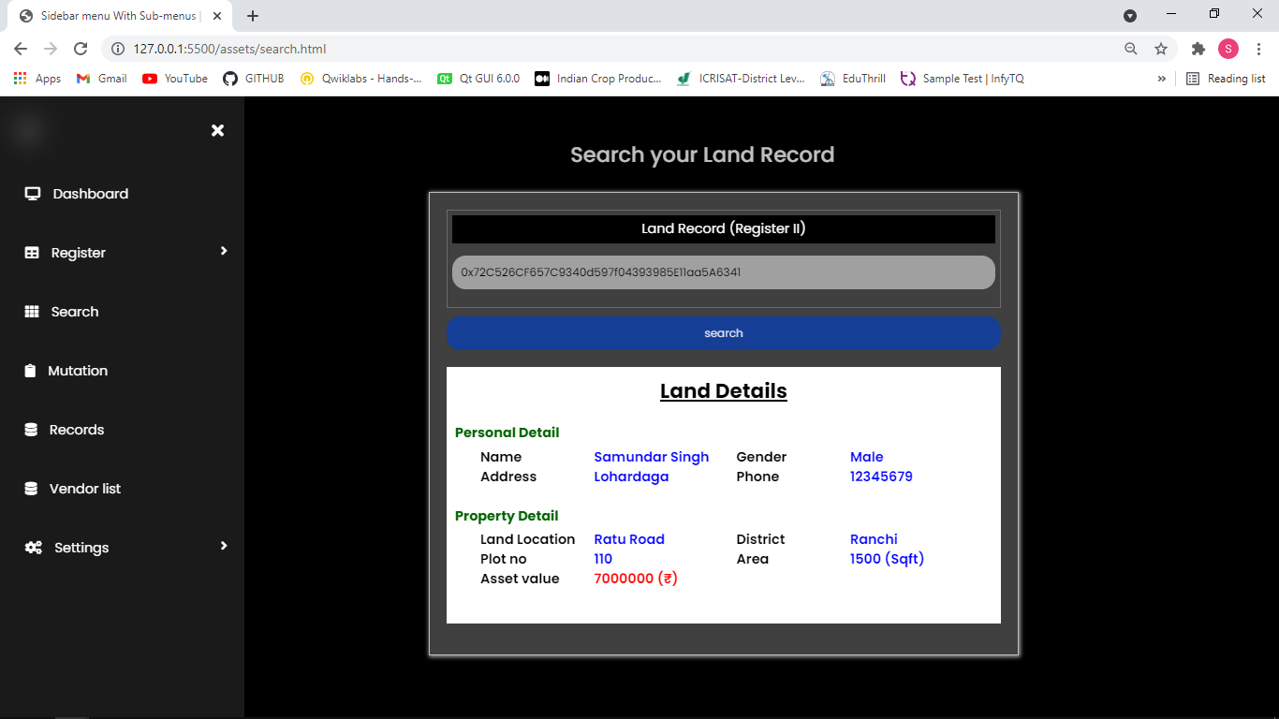
Work Completed

Slide 12
THANK YOU
For watching our presentation!

